Slide 1
2 User Scenarios
1. CHIO - wants to recommend training for new CAC
2. CAC - has a work request to complete a heuristic on a Clinical Reminder Dialog Template.

Slide 2
CHIO Train New CAC

Slide 3

CHIO - wants to recommend training for new CAC
Needs:
Find appropriate training
Decide if worth the time/cost
Communicate to employee
Recommendation:
Home Page – add value prop next to site title
Add Training main nav in a more prominent place, relocated Fundamentals.
Reduce rework, improve customer satisfaction.
Training
Success: Time on page, bounce rate.

Slide 4
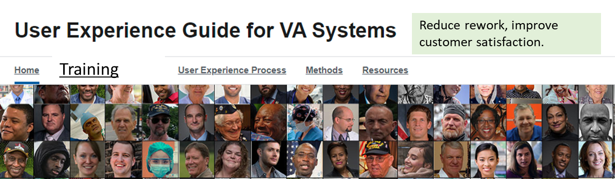
Needs:
Find appropriate training
Decide if worth the time/cost
Communicate to employee
New to User Experience
Method Training
New to User Experience
Learning objectives
Pre reads
Time commitment
Online/classroom
Coaching available
Method Training
List of methods
(each one would go to a learning module that includes the method page from the Methods nav item, but also additional content.)
V
CHIO decides on a method – customer grid
Selects it from a list.
Method page includes a Share function – CHIO sends page to self, or to employee, with a note on how/when to get started.
Follow up: As employee completes modules, CHIO is automatically updated. (Means that the CAC when starting a training module must indicate CHIO and contact details.
Success: Time, clicks/taps, golden path analytics.

Slide 5

Needs:
Find appropriate training
Decide if worth the time/cost
Communicate to employee
Customer Grid Training
Definition
When used
Resources involved
Time commitment
Sample grids
Sample reports
FAQ
Content from the Methods>Customer Grid page in Primary Nav
No clicks for first 4 items, on page.
Click away to the samples, etc.
Share with: email address field
Add note: (optional)

Slide 6
CAC Work Request

Slide 7
CAC Needs:
Learn what a heuristic review is
Find out how to execute
Obtain coaching to check to the report
CAC Work Request
Psychotherapy wants CAC to build CRDT to help make all the providers work consistently across VHA.
SME already have requirements. May receive an email that says- build a CRDT with these 3 fields. And save the inputs as health factors. Coded structured data not free text. CRDT must be used since only one to save coded data. Make sure it has good usability (could be in the request, or a mgmt. directive) by conducting a heuristic review.

Slide 8

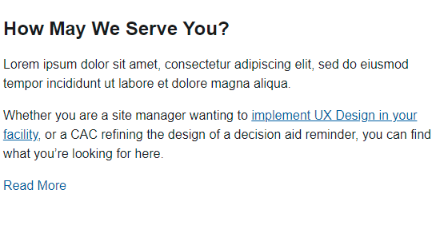
CAC Needs:
Learn what a heuristic review is
Find out how to execute
Obtain coaching to check to the report
CAC spots the site search – prefers to search over browse a site.
As a CAC, I need to:
Start a new project and incorporate user centered design
Midway in a project, asked to evaluate the design for usability
Perform user testing to establish benchmark before a redesign
Track usability goals within the context of the project
Perform a heuristic review on a new site
Success: Click/tap on an item here. Compared to the number of visits. Determine if these items resonate, or if the CAC generally ignores and uses site navigation to look for information.

Slide 9



CAC Needs:
Learn what a heuristic review is
Find out how to execute
Obtain coaching to check to the report
CAC types heuristic or expert review, clicks Go or Search (not a mag glass)
Heuristic review
Your search for “Heuristic review” resulted in 9 matches.
Glossary definition: In a heuristic evaluation, usability experts review your site’s interface and compare it against accepted usability principles. The analysis results in a list of potential usability issues.(Usability.gov)
Watch team complete a heuristic review. 9:13 m
How to perform a heuristic review. 3 MB
Home > Methods > Heuristic review Site page

Slide 10
CAC Needs:
Learn what a heuristic review is
Find out how to execute
Obtain coaching to check to the report
CAC types heuristic or expert review, clicks Go or Search (not a mag glass)
Heuristic review
Your search for “Heuristic review” resulted in 9 matches.
Glossary definition: In a heuristic evaluation, usability experts review your site’s interface and compare it against accepted usability principles. The analysis results in a list of potential usability issues.(Usability.gov)
Watch team complete a heuristic review. 9:13 m
How to perform a heuristic review. 3 MB
Home > Methods > Heuristic review Site page
Some content, such as the video and the PDF are cross linked in the site page, this just informs the user that these types of resources are available.

Slide 11
CAC Needs:
Learn what a heuristic review is
Find out how to execute
Obtain coaching to check to the report
CAC types heuristic or expert review, clicks Go or Search (not a mag glass)
Heuristic review
Your search for “Heuristic review” resulted in 9 matches.
Glossary definition: In a heuristic evaluation, usability experts review your site’s interface and compare it against accepted usability principles. The analysis results in a list of potential usability issues.(Usability.gov)
Watch team complete a heuristic review. 9:13 m
How to perform a heuristic review. 3 MB
Home > Methods > Heuristic review Site page
Sample Heuristic Report 2MB
Request coaching call. Form
Complete online form to schedule a call from one of the UX specialists at VHA.
Search success: click/tap on a result. Can analytics tell what terms are searched for and if users go to pages provided as result. If not, use explicity questions.

Slide 12

CAC Needs:
Learn what a heuristic review is
Find out how to execute
Obtain coaching to check to the report
CAC types heuristic or expert review, clicks Go or Search (not a mag glass)
Heuristic review
Your search for “Heuristic review” resulted in 9 matches.
Glossary definition: In a heuristic evaluation, usability experts review your site’s interface and compare it against accepted usability principles. The analysis results in a list of potential usability issues.(Usability.gov)
Watch team complete a heuristic review. 9:13 m
How to perform a heuristic review. Site page
Home > Methods > Heuristic review Site page
Request coaching call. Form
Complete online form to schedule a call from one of the UX specialists at VHA.
Are these what you need?

Slide 13
When user lands on a video via browse or search results:
Video should include the recommendation to go to the Method page, to be able to utilize the resources there such as worksheets etc. And it should recommend the appropriate playbook.
For video, the success measure is starting a video. (For other clients that UV supports the measure of success is the % of video watched which comes from analytics with proper tagging)
Cross linking
Video poster on page
End of video contains cross links to related content.
Check on the additional materials on the Heuristics page. They include easy to use worksheets.
Watch a team perform a heuristic exercise. 9:13 m:s

Slide 14
How To Conduct Heuristic Review
Indicate resource needs, e.g. more than one person, each one review xyz materials before, access to product.
Time estimate:
Formatted as steps
Cross links to:
Sample reports
Video
Training
Worksheets
V
Back to top control

Slide 15
Obtain Coaching
Please complete all fields below.
Topic (free text or select from list)
Free text: what is your question?
Contact details
Calendar for scheduling? Use a shared calendar so people can sign up for a time and then get reminders (think Doodle)
Cross links to:
Sample reports
Video
Training
Worksheets
V
Back to top control

